Slide 1
System Design Fundamentals
2021, Algo Export
Yang Xi’s Reading Note

Slide 2
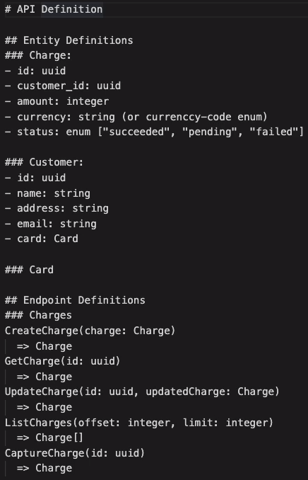
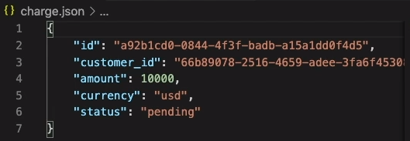
API Design Overview
Permanence: once an API is released to production, changing it will become extremely difficult
API needs to be designed carefully to the very minor detail
Big companies have very rigorous review process of API
Outline of an API
Which part does this API lie on the website?
Who will consume it? And how will it be used?
What entities or resources the API relies on?
What these resources or entities look like, what properties / attributes they have?
What are the API endpoints?
What are the parameters the API end points take?
What are the responses the API end points return?

Slide 3
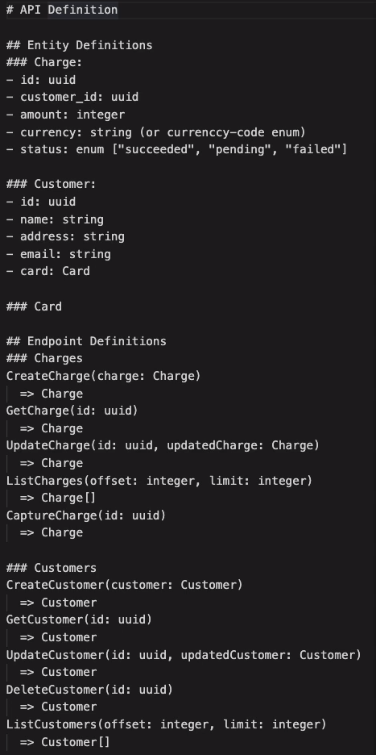
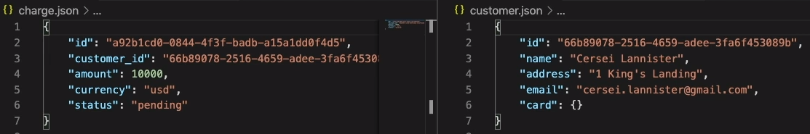
Card obj has subfields
5 endpoints for charges
Parameters, and types of the parameters
Response
Pagination parameters, such as “GET /ListCharges?limit=20&offset=100”

Slide 4
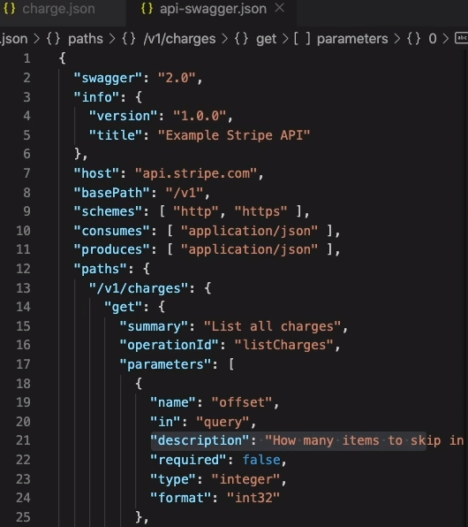
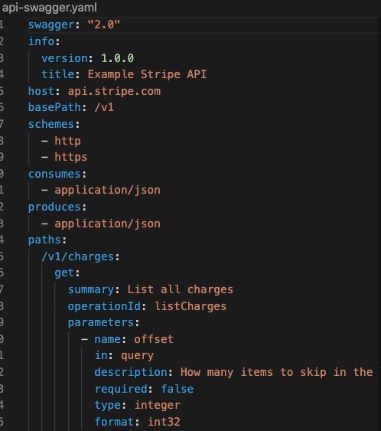
Format of API Outline
Swagger
Swagger is an Interface Description Language (IDL) to describe APIs
Yaml

